Slide 1
CSE221
Structure and Interpretation of
Computer Programs
D
Small practice problems on procedures

Slide 2
Overview of previous lectures
Primitive expressions
Example: 486, 10, 100 etc.
Compound Expressions
Example: (+ 4 5)
(* 1 2 8 9)
Nested Expressions:
Example: (* 3 (+ 4 5) (+ 5 8))
Primitive Procedures:
Example: (+ 4 5), (- 5 4)
(define N 10) (Special one)

Slide 3
What is the Output for the
Following Exps?
10
?
(+ (* 2 4) (- 4 6))
(+ 8 (-2))
6
?
(= 3 4)
?

Slide 4
What is the Output for the
Following Exps?
  (define a 3) a = ?
  a=3
  (define b (+ a 1)) b = ?
  (define b (+ 3 1)
  (define b 4)
  Hence, b = 4
  (+ a b (* a b)) ?
  (+ 3 4 (* 3 4))
  (+ 3 4 12)
  19
  (if (> a b) ("a is larger") "b is larger“) “? is larger”
  (if (> 3 4) ("a is larger") "b is larger“)
  (if # f ("a is larger") "b is larger“)
  Result: “b is larger”

Slide 5
Defining procedures / functions
By means of abstractions.

Slide 6
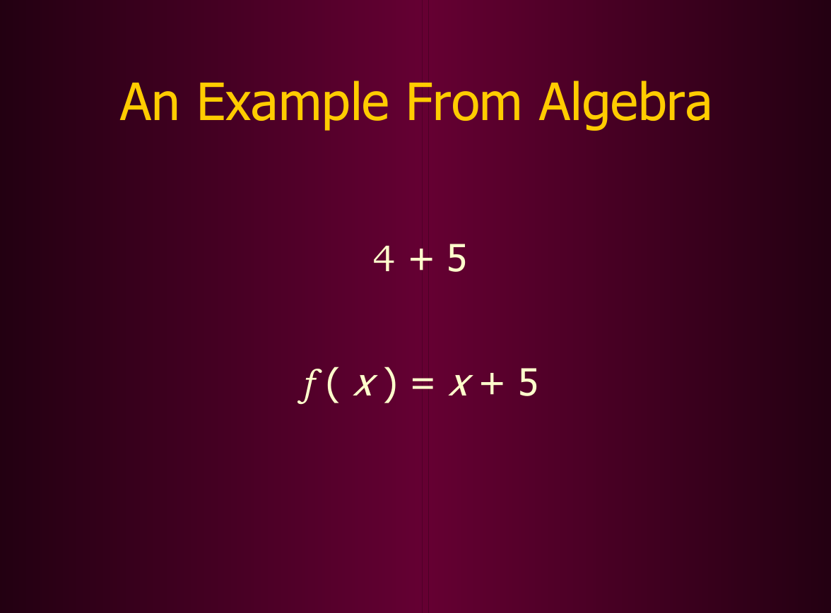

Slide 7
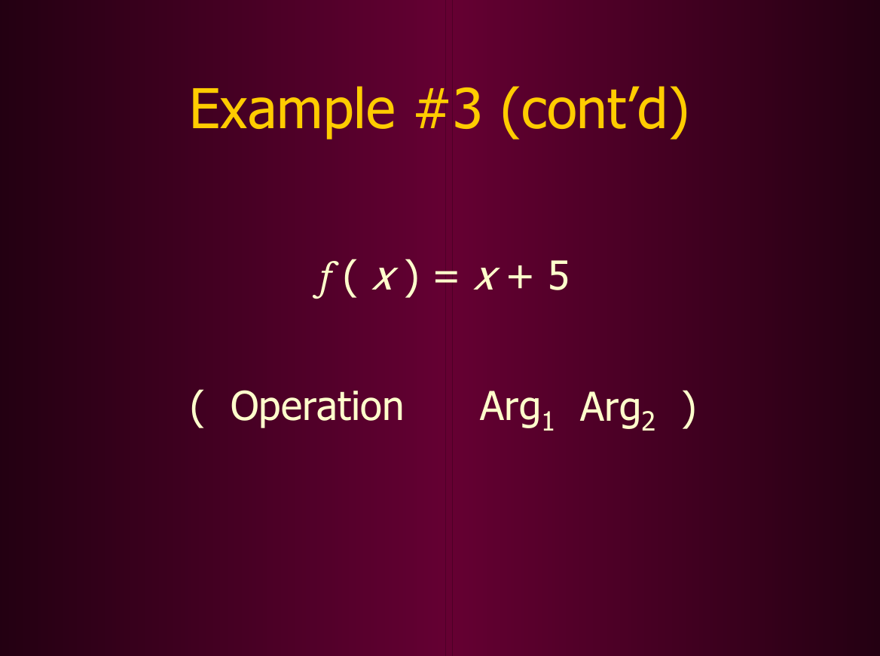

Slide 8
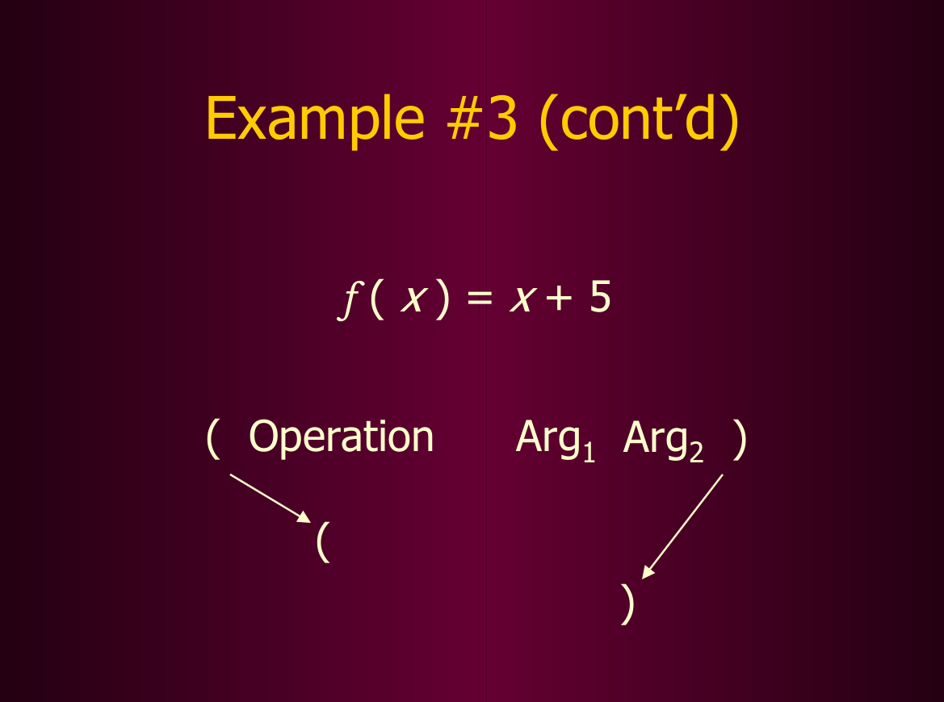

Slide 9
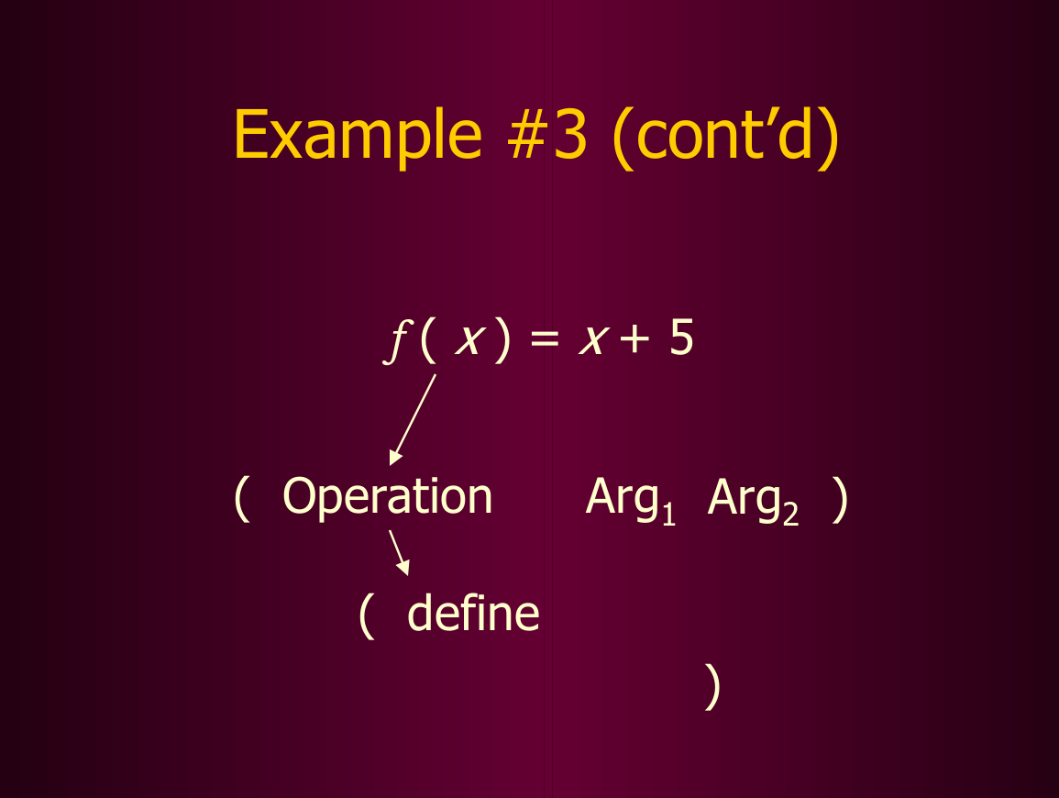

Slide 10
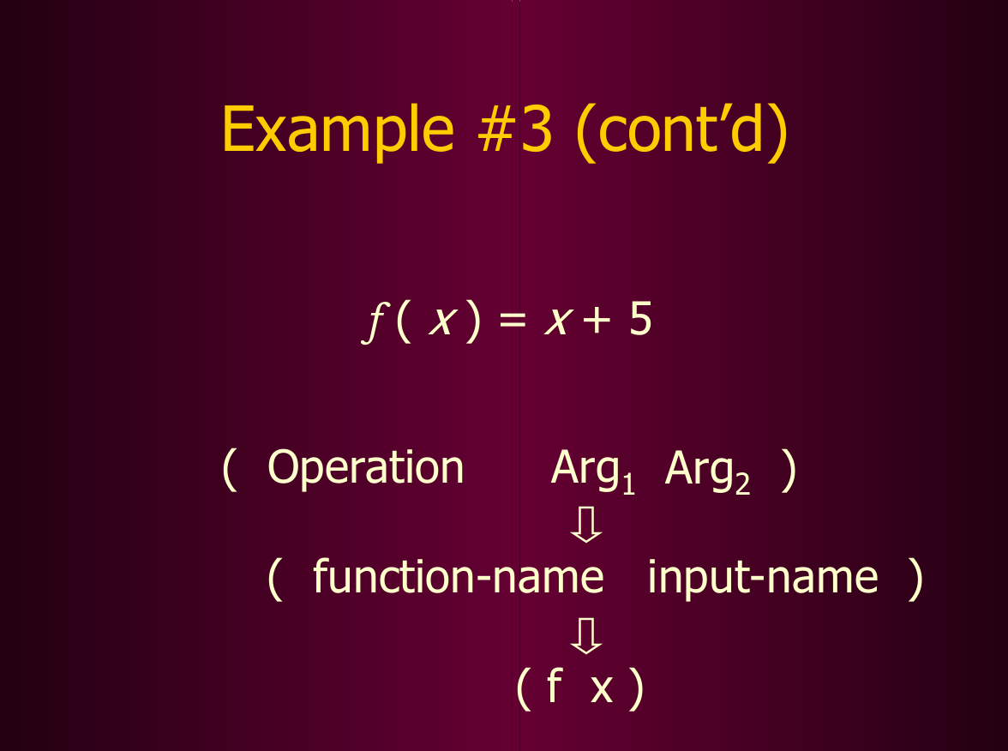

Slide 11
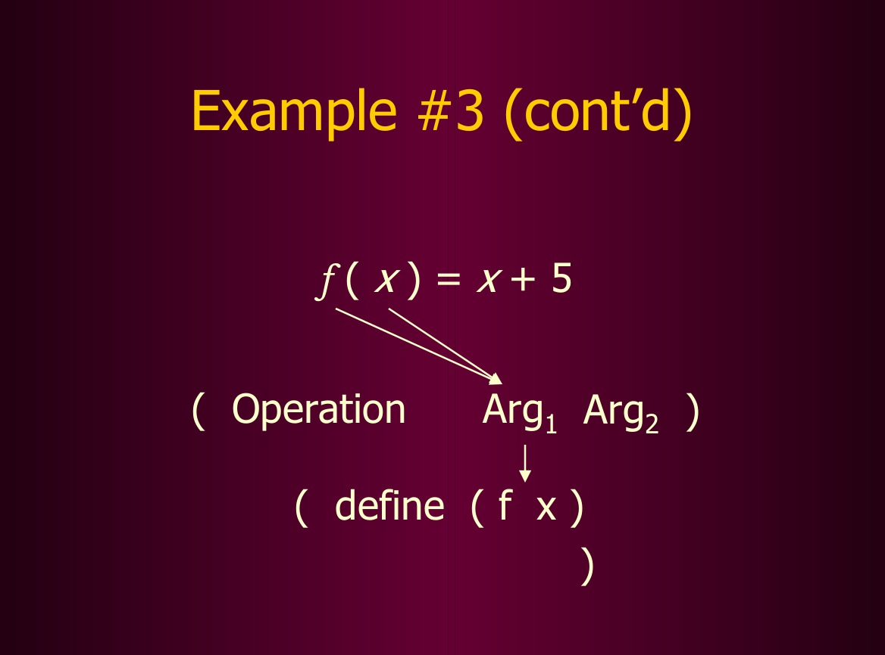

Slide 12
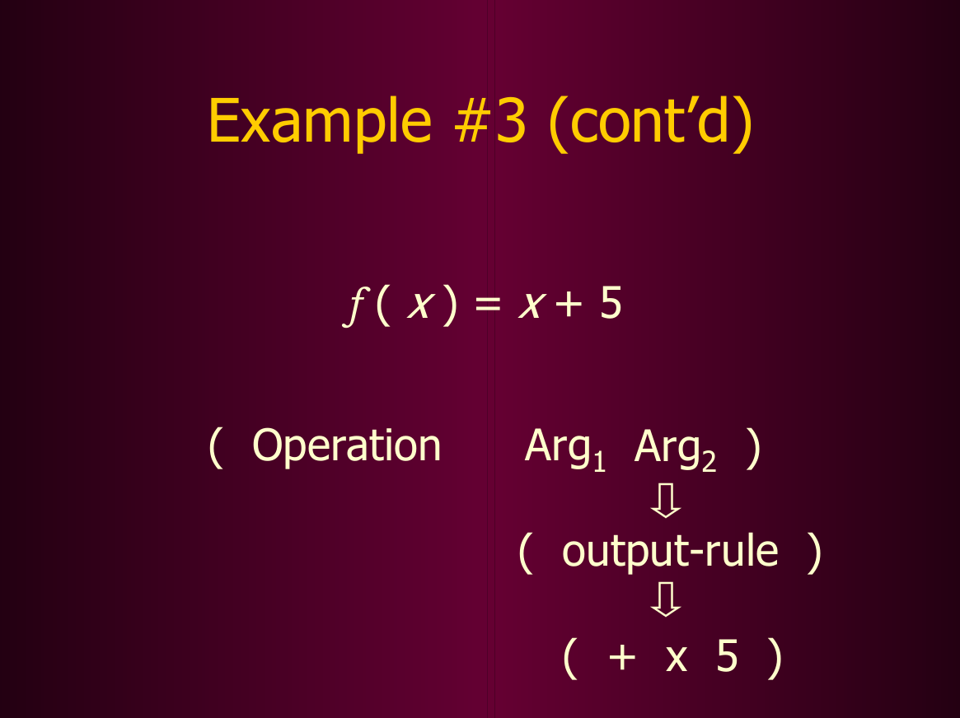

Slide 13
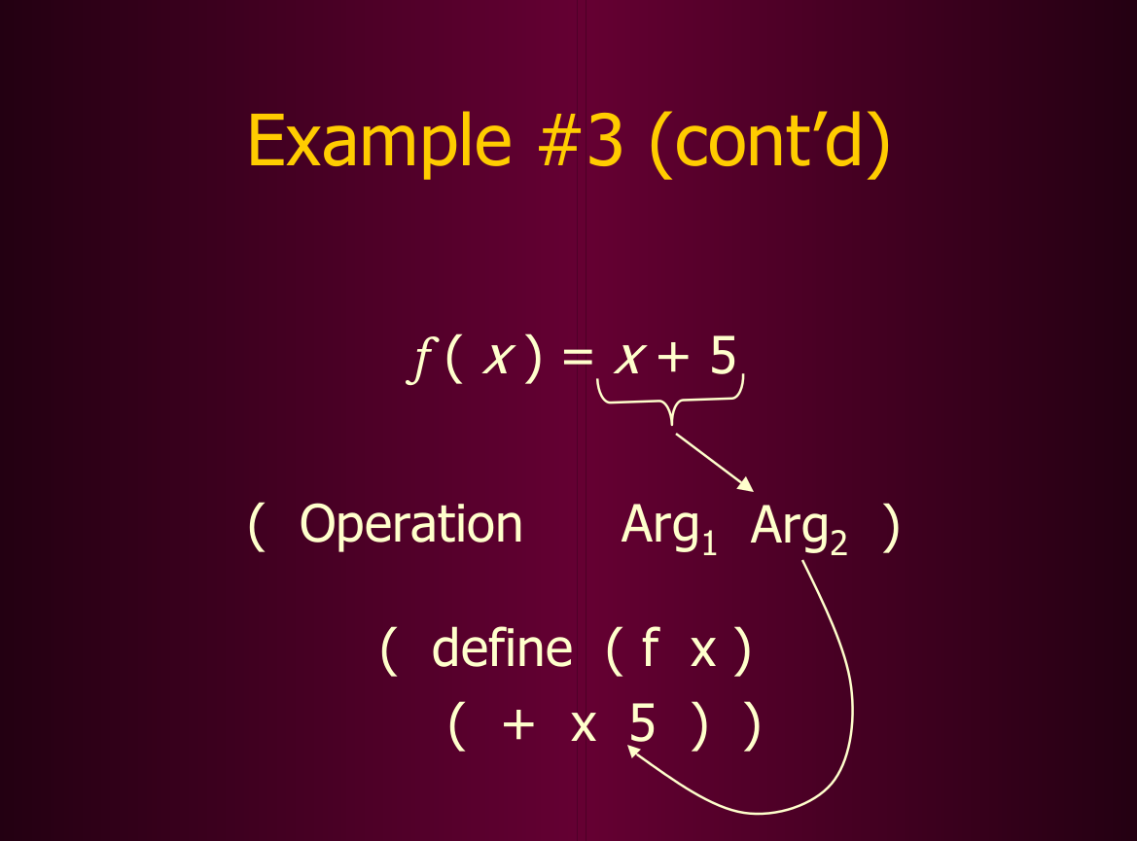

Slide 14
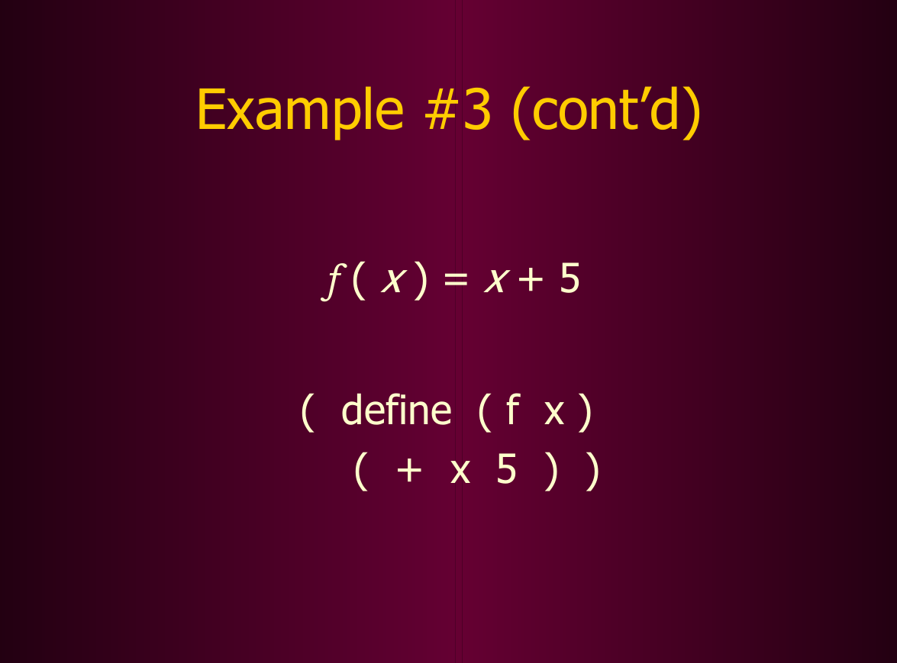

Slide 15
Define function : square (x) = x * x
(define (func-name formal-param)
( func-body))
(define (square x)
(* x x))

Slide 16
The sum-of-squares procedures
Sum-of-squares (x, y) = x² + y²
( define (sum-of-squares x y)
(+ (* x x) (* y y) ) )
OR
(define (sum-of-squares x y)
(+ (square x) (square y)))
Procedural Abstraction

Slide 17
Define a procedure to test
whether one number is
greater than or equal to
another number.

Slide 18
gteq ( x, y ) => ( x > y ) or ( x = y)
(define (gteq x y)
(or (> x y) (= x y)))

Slide 19
gteq ( x, y ) => ( x > y ) or ( x = y)
(define (gteq x y)
(or (> x y) (= x y)))
OR
(define (>= x y)
(or (> x y) (= x y)))

Slide 20
Define a procedure
a-plus-abs-b

Slide 21
a-plus-abs-b ( a, b ) => a + abs (b)
(define (a-plus-abs-b a b)
(+ a (if (< b 0) (–b) b)))

Slide 22
a-plus-abs-b ( a, b ) => a + abs (b)
(define (a-plus-abs-b a b)
(+ a (if (< b 0) (–b) b)))
OR
(define (a-plus-abs-b a b)
(+ a (abs b))
(define (abs x) (if (< b 0) (- b) b))

Slide 23
a-plus-abs-b ( a, b ) => a + abs (b)
Based on primitive procedure selection
(define (a-plus-abs-b a b)
( (if (> b 0) + -) a b))
Bb=10
Bb = -10
+
Hence eq reduces to
(+ a b)
(+ a 10)
-
Hence eq reduces to
(- a b)
(- a (- 10))
Returning a procedure ‘+ ‘

Slide 24
Define a procedure that
takes three numbers as
arguments and returns
the sum of the squares
of the two larger numbers

Slide 25
Fully expanded expressions (tedious isn’t it?)
(define (sum-of-largest-two x y z)
(if (= x (if (> x y) x y)) Finds larger between x & y
(+ (* x x) (* (if (> y z) y z) (if (> y z) y z) )) x^2 + (y /or z) ^ 2
(+ (* y y) (* (if (> x z) x z) (if (> x z) x z))) y^2 + (x or z)^2
)
)

Slide 26
Applying procedures at different levels
Procedural abstraction for sum-of-squares method
(define (largest-two-square-sum x y z)
(if (= x
(if (> x y) x y)
(sum-of-squares x (if (> z y) z y) )
(sum-of-squares y (if (> x z) x z) )
)
)

Slide 27
Applying procedures at different levels
Procedural abstraction for larger() procedure
(define (largest-two-square-sum x y z)
(if (= x (larger x y)
(sum-of-squares x (larger y z))
(sum-of-squares y (larger x z))
)
)
Larger (x,y) procedure
(define (larger x y)
(if (> x y) x y))

Slide 28
Applying procedures at different levels
By using min function
(define (sum-of-largest-two x y z)
(cond ((= x (min x y z)) (sum-of-squares y z))
((= y (min x y z)) (sum-of-squares x z))
((= z (min x y z)) (sum-of-squares x y))
)
)

Slide 29
Write a procedure that calculates the grade for given marks

Slide 30
Grade calculation
(define (grade-calculation marks)
(cond ((and (< marks 100) (>= marks 80)) "Grade-A")
((and (< marks 80) (>= marks 70)) "Grade-B")
((and (< marks 70) (>= marks 60)) "Grade-c")
((and (< marks 60) (>= marks 50)) "Grade-AD")
((< marks 50) "Grade-Fail")
)
)

